Slide 1
jQuery

Slide 2

What is jquery?
jQuery is a fast, small, and feature-rich JavaScript library.
It makes things like:
HTML document traversal and manipulation
event handling
Animation
Ajax
much simpler with an easy-to-use API that works across a multitude of browsers.

Slide 3
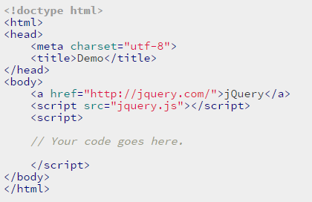


Slide 4
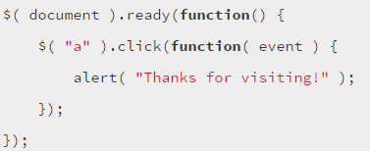


All <a> elements are now bold

Slide 5
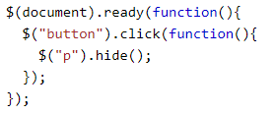
What will this do?

Slide 6
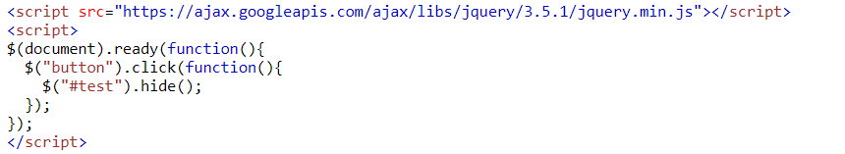
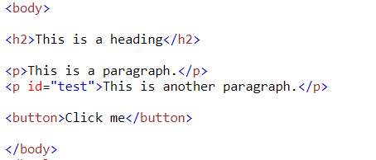
CSS selectors! Oh! Lovely.

Slide 7

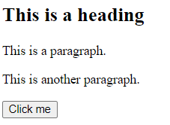
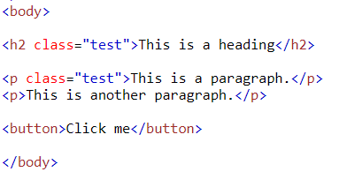


Slide 8
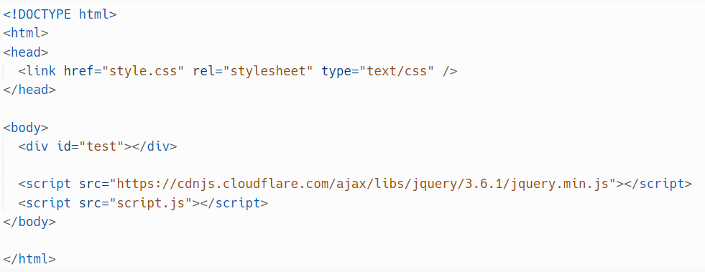
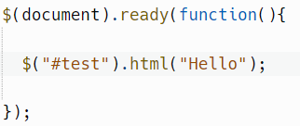

We can tidy the code up a little by putting our code into an external file (script.js) and using a CDN

Slide 9
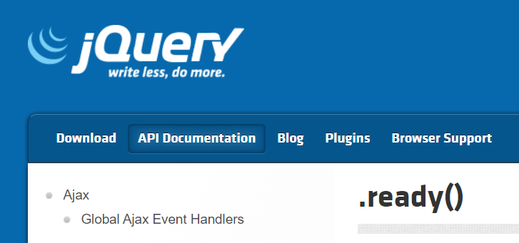

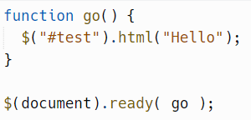
Anonymous functions
What is ready() doing?
https://api.jquery.com/ready/
https://replit.com/@JohnGlazebrook/document-ready
? A handler is a function that is called. You need to provide a pointer to that function
https://replit.com/@JohnGlazebrook/document-ready-2

Slide 10
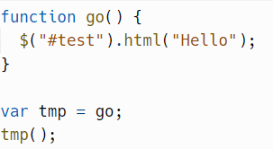
jQuery will often ask for “handler” as a parameter
This handler will get called when the event is triggered
E.g. click event, hide event, etc
The handler is a pointer to a function (or an anonymous function)
go() calls the function and runs the code
go is the pointer to that function
We create a function called go()
Then we assign a pointer to the function to variable tmp
We can then “call” the variable, which runs the function it points at

Slide 11
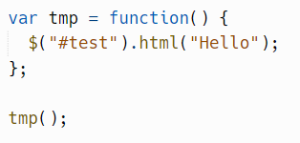
A named function (named “go”)
An anonymous function (has no name)

Slide 12
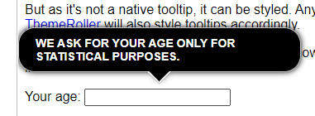
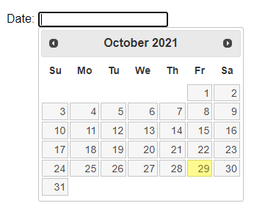
Jquery does a lot of things
https://api.jquery.com/category/selectors/
But selectors are my favourite.
And maybe tooltips https://jqueryui.com/tooltip/#custom-style
And the calendar/datepicker https://jqueryui.com/datepicker/

Slide 13
task
Complete the tutorial:
https://www.w3schools.com/jquERy/default.asp

